Slide 1
Agent Network Platform
Managing agent network on system

Slide 2
Background

Slide 3

Where are we now?
In 2020 we embarked on a project to move the management of KOKO’s agent network ‘on system’ and away from spreadsheets.
Managing the agent network involves 7 teams operating >35 processes. Some processes were well defined while others need redesigning.
The challenge is deciding what to build first to so that the system becomes the source of truth for agent network management.
Not all the processes need to be done on system right away but enough data needs to be there to stop people reverting to spreadsheets.
Therefore we have narrowed the focus to building an MVP (minimum viable product) for onboarding and offboarding (agents, shops and KPs).

Slide 4
MVP for managing Agent Network on system
The MVP (minimum viable product) for managing the agent network on system is constantly changing as we learn more about running the business.
Replicating existing fields in spreadsheet covers the goal of replacing spreadsheets but will quickly be out of sync if another process not on system changes that status.
Replicating all processes on system will take time and mean value of the UVA workstream won’t be achieved until late 2021.
The MVP is somewhere in the middle taking into account how agents, shops and KPs move through the lifecycle.
It’s important to note the MVP is not the end of development on the agent network platform ….
Time
Agent Network Processes
All agent related processes on system.
MVP
Replicating fields in spreadsheet

Slide 5
Agent Process Outline
Agent | Prospect Agent Recruitment (AN) Agent KYC (Legal) | Active Payments (Finance) Termination (Agent Network) | Inactive
Shop | Prospect Shop Selection (AN) Shop KYC (Legal) Contracting (Legal) Payments (Finance) Inspection (Deployment) Civil Works (Deployment) Branding (Marketing) Shop readiness (Deployment) | Active Commissions (Finance) Agent Sales (AN) Termination (AN) Relocation (AN) Suspension (AN) Deliver Inventory (Cookers) | Archive Final dues (Finance) Retrieve Inventory (Deployment) Retrieve Branding (Deployment)
KOKO Point | Warehouse QC (Deployment) Repairs (Deployment) Deliver (Deployment) KP readiness (Deployment) Install (Deployment) Fuelling (Fuels) Calibration (Deployment) | Deployed Commission (NOC) Fuelling (Fuels) Maintenance (NOC) Calibration 2.0 (Deployment) Relocation (Deployment) Decommission (Deployment) | Scrapped Repair (Deployment) Break down (Deployment)
We brainstormed all the current processes that take place and mapped them to the relevant entity and lifecycle phase.
Individual processes have different owners and actors (see brackets) even though the overarching network is managed by the Agent Network Team.

Slide 6
Agent Process MVP
Agent | Prospect Agent Recruitment (AN) Agent KYC (Legal) | Active Payments (Finance) Termination (AN) | Inactive
Shop | Prospect Shop Selection (AN) Shop KYC (Legal) Contracting (Legal) Deposits (Finance) Inspection (Deployment) Civil Works (Deployment) Branding (Marketing) Shop readiness (Deployment) | Active Commissions (Finance) Agent Sales (AN) Termination (AN) Relocation (AN) Suspension (AN) Deliver Inventory (Cookers) | Archive Final dues (Finance) Retrieve Inventory (Deployment) Retrieve Branding (Deployment)
KOKO Point | Warehouse QC (Deployment) Repairs (Deployment) Deliver (Deployment) KP readiness (Deployment) Install (Deployment) Fuelling (Fuels) Calibration (Deployment) | Deployed Commission (NOC) Fuelling (Fuels) Maintenance (NOC) Calibration 2.0 (Deployment) Relocation (Deployment) Decommission (Deployment) | Scrapped Repair (Deployment) Break down (Deployment)
Then we outlined which processes must be online and should be online in order to stop managing the agent network on spreadsheets
Key:
Must be
Should be / Next
Offboarding and Onboarding are two key processes that involve multiple subprocesses so we went into a more detailed mapping process for these.

Slide 7
Workshop Write Up

Slide 8
Workshop Objectives
In order to do detailed feature design to feed into software development, we need to clarify the following:
Validate processes: Are these the right stages for onboarding & decommissioning? Is anything in the wrong sequence? Is anything missing?
Team Roles: Which specific roles are involved with each stage? What does each role do (eg, in context of RACI)?
Statuses: What are the appropriate statuses for each stage? Have we captured them appropriately?
How will we update statuses? Automated (rules-based) vs. manual?
If automated, what are the rules?
If manual, who should have permission to change which statuses?
User Updates: How should we inform users about status changes? Who should be informed about which items?
Email? Tableau? Other?
Adjacencies: What other existing processes touch these steps (eg, fuel planning?)
Resolve open questions and feedback on terminology.

Slide 9
Next steps post workshop
Agree and sign off on the agent lifecycle phases [slide 10]
Sign off on the final high level process flow as agreed in workshop [slides 11-12]
Sign off on process status changes for onboarding including notifications and triggers [slide 13]
Review and agree the onboarding MVP scope and UI [slide 14 - 18]
Roadmap discussion [slide 23 onwards]

Slide 10
1 Agree Lifecycle Phases
Agent
Entity | Lifecycle Phases
Agent | Prospect | Active | Inactive
Shop | Enrolled | Active | Disenrolled
KOKO Point | Warehoused | Deployed | Scrapped
0..1
owns
1..n
Shop
1..n
Action: Agree final terminology for these
Questions:
How do we differentiate between an active shop and an active agent? Do we need different names for these? Suggestions: Rename shop phase to xxx
How do we differentiate between a prospect shop and prospect agent? Do we need different names for these? Suggestions: Rename shop to ‘Under Review’
houses
0..n
KOKOpoints

Slide 11
2 Agree Onboarding
Offline process for MVP
Online process for MVP
Identify new
location
Create agent and shop
Collect Deposit
N.B. Elements of deposit, KYC and contracting happen in parallel. The key thing is no civil works should start until all three are marked as complete on system. Completed contract/agreement means a countersigned contract being uploaded to the system.
Mark as paid?
Pass?
Inspection
Collect KYC (business permit, national ID and KRA pin)
Civil works
Checked?
Complete?
Collect signed contract
Counter- signed contract uploaded?
Delivery
Archive agent & shop
Complete?
Branding
Complete?
Shop & KP active
Complete?
W&M Sealing
Systems
Group
Sealing
Calibration
Fuelling
Installation
Complete?
Complete?
Complete?
Notes:
Can we only fuel a KP that is active? How do the first ones get filled? If they are not linked on system?
Is cooker delivery a mandatory step? Only really happens once shop is active?
Need a requirement for archiving a shop from prospect status.

Slide 12
2. Agree Offboarding
Offline process for MVP
Online process for MVP
Agent wants to leave KOKO
The correct tobe process is
still being worked through
by Legal and Agent
Network but the on system
process assumes the
termination is approved
and only starts from that
point.
Agent Network informs Legal of a termination
Legal issue formal notice
ARM/ARR send to agent to sign
Agent signs
Termination letter is filed
KOKO decides to terminate shop
Termination status updated
Teams are informed
Decommission tasks start
Finance processes payments
Shop and agent termination?
Automated system triggers
Decommission Tasks:
Retrieve KP
Modifications
Collect cookers and canisters
Retrieve branding
Mark as complete?
Automated system triggers:
Update Odoo agent and shop status for monthly statements
Adjust min/max values
Unassign KP from a shop
System marks agent inactive

Slide 13
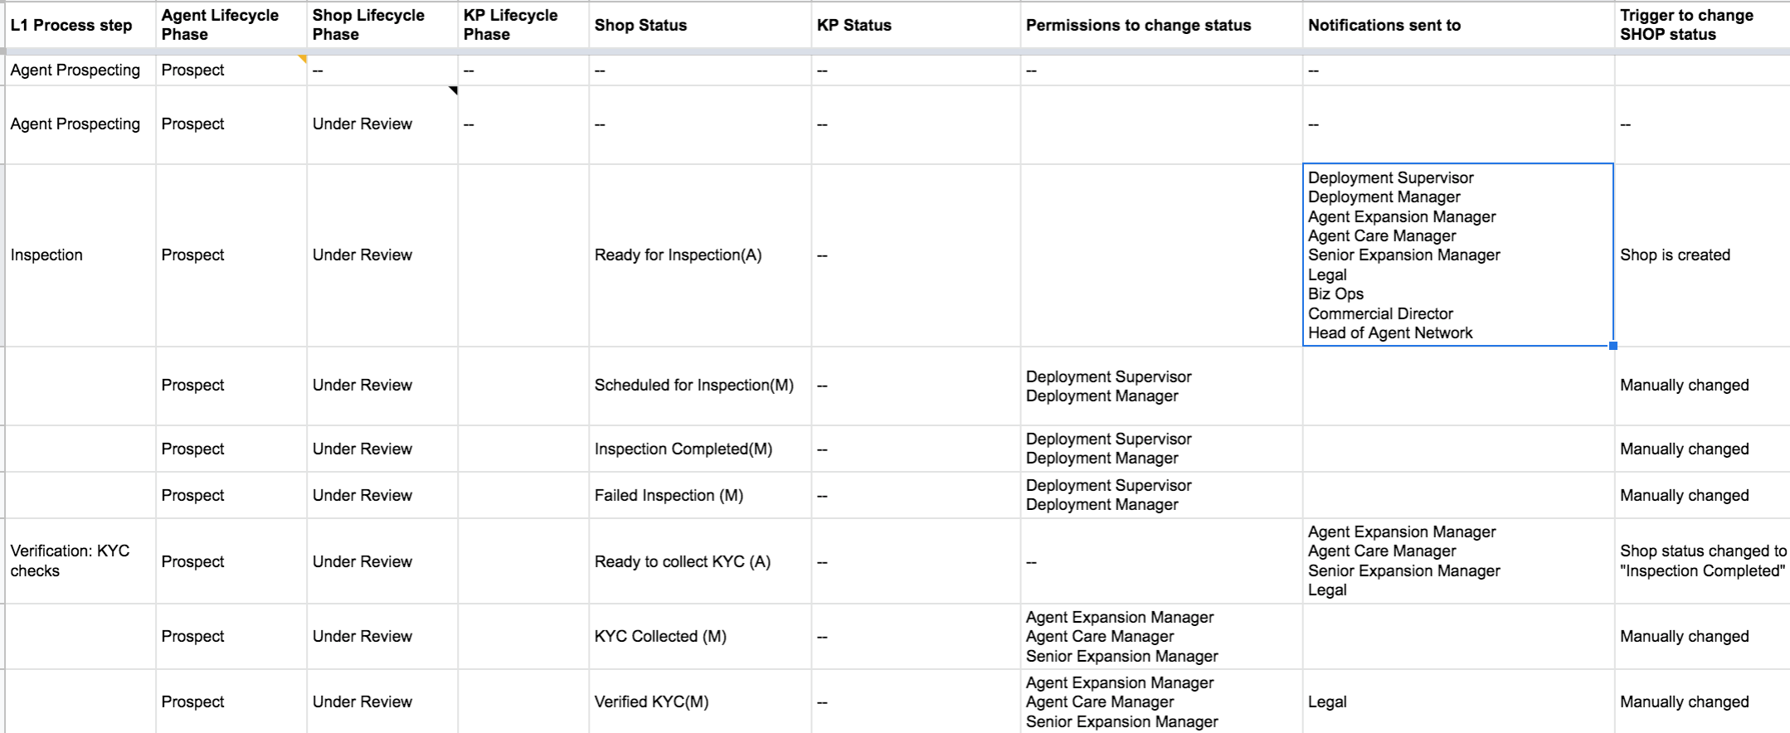
3. Agree process, status and triggers
The complete write up for each individual status including triggers and notifications is now available in the Agent Lifecycle Sheet.
Action: Incorporate any feedback from Ari and Akofa by Tuesday 2nd March; complete follow ups with wider agent team by Friday 5th March.

Slide 14
4. Onboarding MVP Designs
Please note this deck includes low fidelity wireframes as opposed to the final high fidelity clickable prototype. We are sharing this for early feedback.

Slide 15
Onboarding Flow
Offline process for MVP
Online process for MVP
Identify new
location
Create agent and shop
Collect Deposit
N.B. Elements of deposit, KYC and contracting happen in parallel. The key thing is no civil works should start until all three are marked as complete on system. Completed contract/agreement means a countersigned contract being uploaded to the system.
Mark as paid?
Pass?
Inspection
Collect KYC (business permit, national ID and KRA pin)
Civil works
Checked?
Complete?
Collect signed contract
Counter- signed contract uploaded?
Delivery
Archive agent & shop
Complete?
Branding
Complete?
Shop & KP active
Complete?
W&M Sealing
Systems Sealing
Calibration
Fuelling
Installation
Complete?
Complete?
Complete?
Notes:
Can we only fuel a KP that is active? How do the first ones get filled? If they are not linked on system?
Is cooker delivery a mandatory step? Only really happens once shop is active?
Need a requirement for arhiving a shop from propspect status.

Slide 16
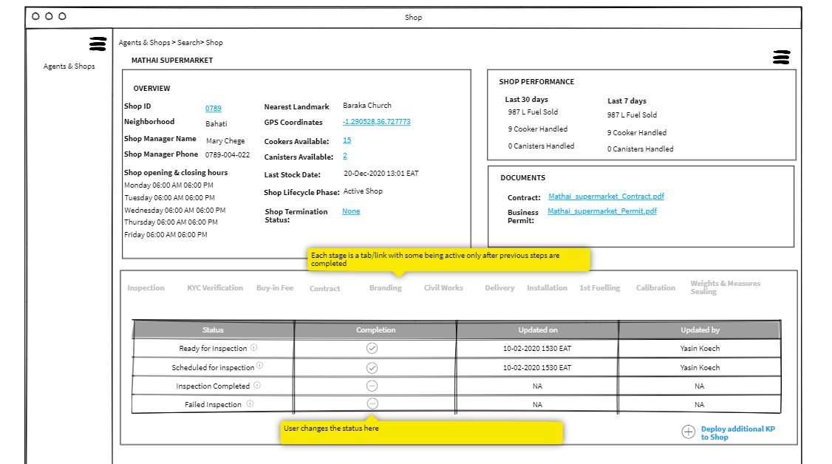
Onboarding Option 1
The first design option lays out the process steps in chronological order. It is a simple UI but it doesn’t allow the user to see any group of stages. e.g. contracting, buy in fee and KYC are parallel steps but the user sees them as individual steps.
The UI includes a history of the status change and who updated it.
The user can add an additional KP to a shop

Slide 17
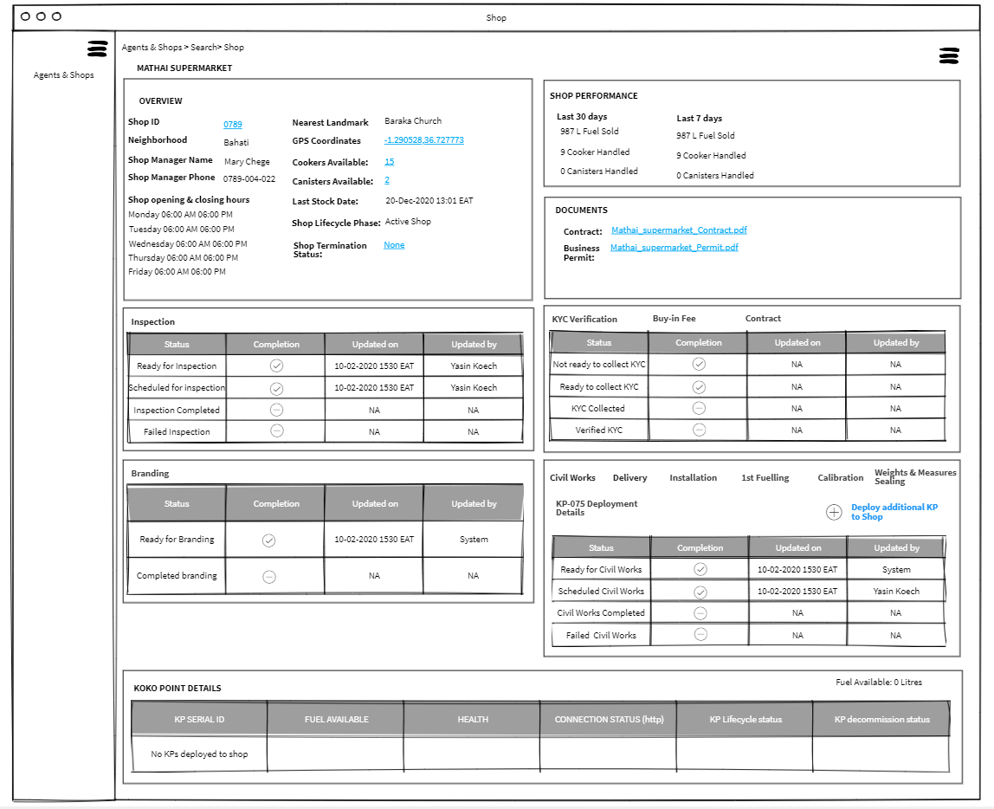
Onboarding - Option 2a
The second design option shows a grouping of steps.
The advantage of this is not all steps are required to deploy a KP. So if deploying a second KP only the deployment tab panel (civil works onwards) would be visible.

Slide 18
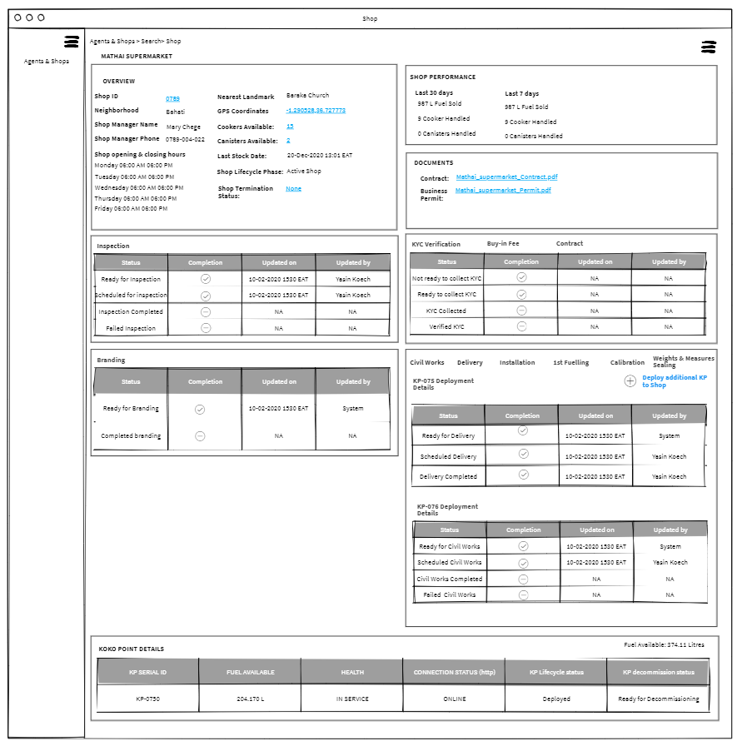
Onboarding Option 2b
See with example of how it looks when a second KP is deployed to a shop.
N.b. Once a KP is deployed the KOKOPoint details table moves up above the onboarding panels on the shop page.

Slide 19
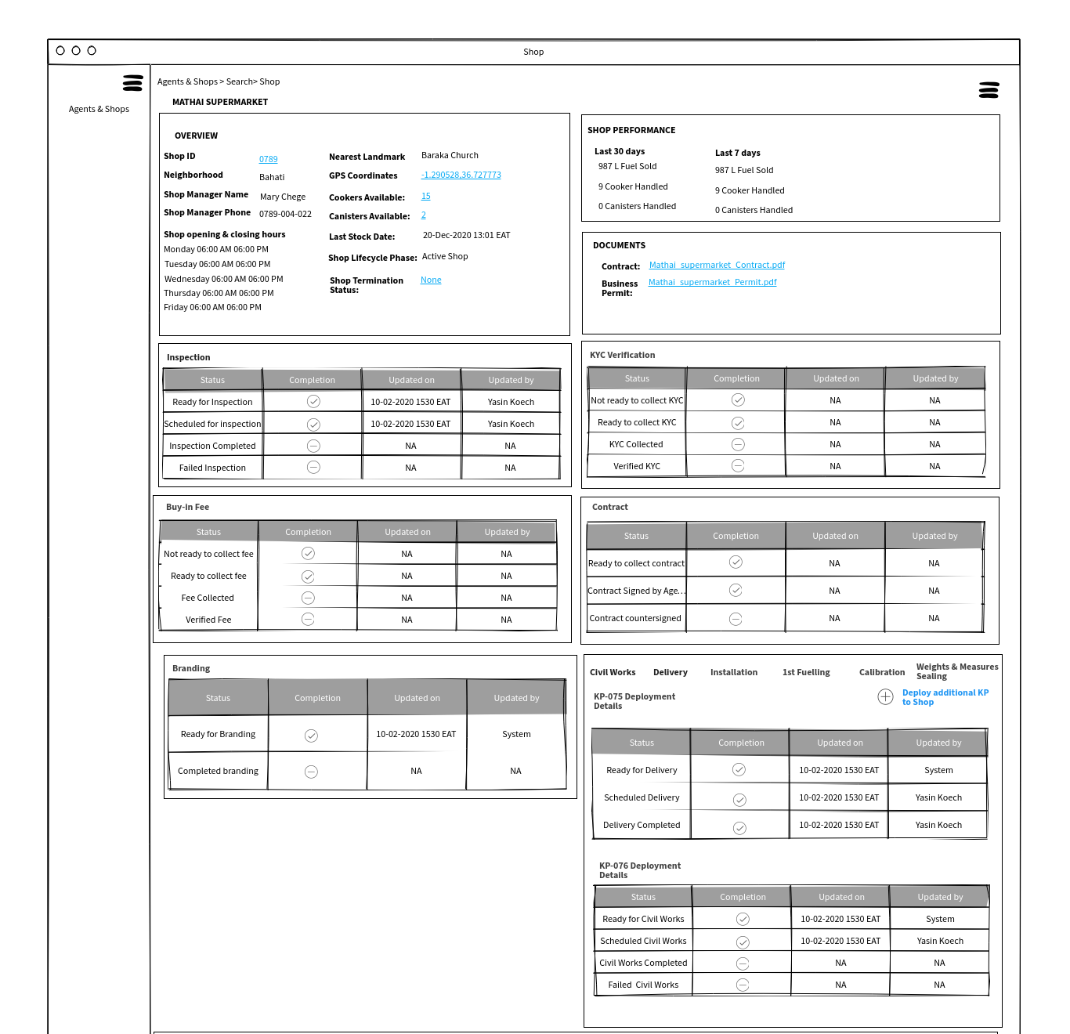
Onboarding 3
The third option shows the KYC, buy in fee and contracting steps on the page together (no clicking on individual tabs). This is because we see a need for Agent Network to see all three at once when checking on the readiness of an agent.

Slide 20
Offboarding MVP
Solution Outline

Slide 21
Offboarding
Offline process for MVP
Online process for MVP
Agent wants to leave KOKO
The correct tobe process is
still being worked through
by Legal and Agent
Network but the on system
process assumes the
termination is approved
and only starts from that
point.
Agent Network informs Legal of a termination
Legal issue formal notice
ARM/ARR send to agent to sign
Agent signs
Termination letter is filed
KOKO decides to terminate shop
Termination status updated
Teams are informed
Decommission tasks start
Finance processes payments
Shop and agent termination?
Automated system triggers
Decommission Tasks:
Retrieve KP
Modifications
Collect cookers and canisters
Retrieve branding and demo cookers
Mark as complete?
Automated system triggers:
Update Odoo agent and shop status for monthly statements
Adjust min/max values
Unassign KP from a shop
System marks agent inactive

Slide 22
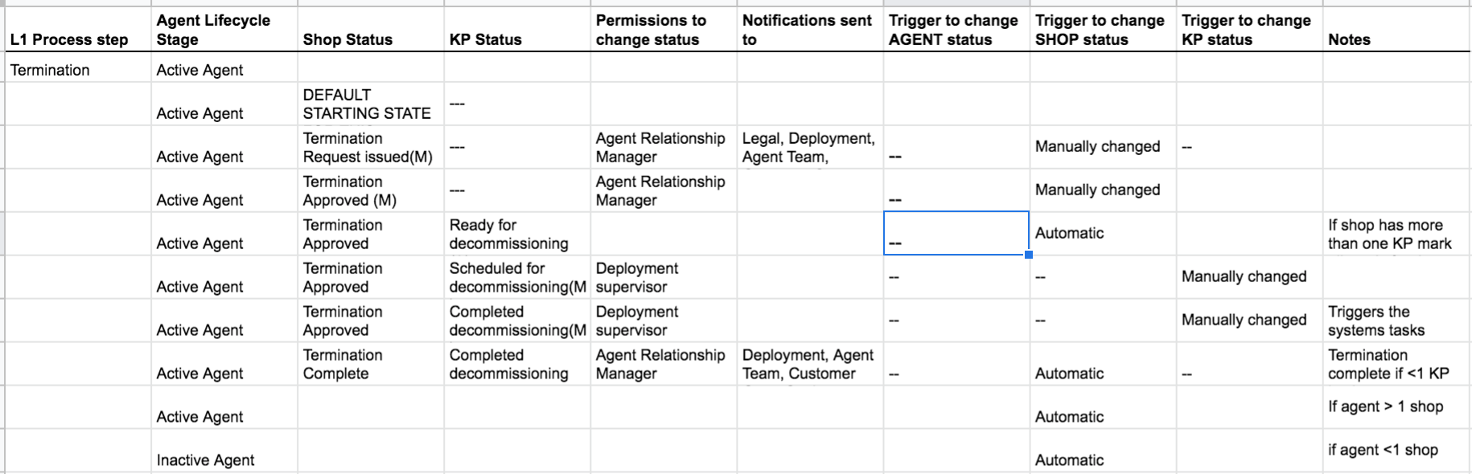
Status Changes and Triggers

Slide 23
User Stories & Designs
Designs
User Stories:
https://kokonetworks.atlassian.net/browse/AW-874
https://kokonetworks.atlassian.net/browse/AW-876
https://kokonetworks.atlassian.net/browse/AW-875

Slide 24
Roadmap implications

Slide 25
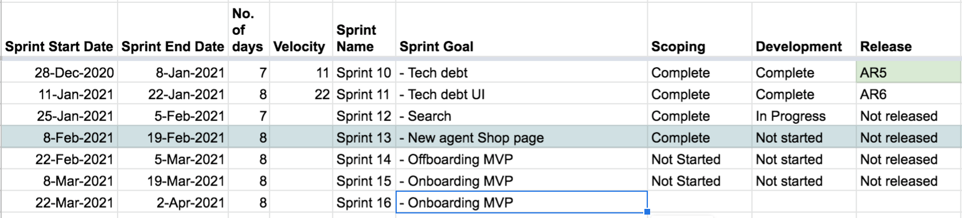
Phasing of onboarding and offboarding
Currently there is a way to create new shops and agents in the UVA portal, which is currently being used by the Agent Expansion Team.
However there is no way to decommission a KP or terminate a shop. This is causing added friction for agent payments, identifying open shops and relocating KPs.
The (initial) scope of offboarding is also smaller than the onboarding process so it is more feasible to scope and build this first.
The impact on the phasing would appear as follows.

Slide 26
Future requirements
The MVP is the beginning of the journey not the end of development. Most off the offline processes will need to come on system at some point during 2021 to allow us to expand the network.
In particular, there is further work to be done around:
Improving agent payments (deposits and commissions)
Schedule and run deployment activities (inspection to calibration)
Visibility of shop visits and deliveries (for us and agents)
Improving agent network management (e.g. ARM assignment)
Incorporate agent issue management (ticketing)
The MVP approach does not block the above from coming in later. Taking the example of deposits, bringing in a settlement process for the agent’s payment and then a check can be easily added to the flow of the existing platform.

Slide 27
Agent Roadmap 2021
The agent roadmap is now available on our new roadmapping tool. Please see here for the view to be discussed Tuesday 2nd March
Main objectives of Unified View of Agent Project
> Ease of access to agent related data
> Stop the reliance of spreadsheets to capture agent related data
> Reduce Odoo license cost
Suspension
Align on shop IDs
ARR assignment
Improve agent payments
Offboarding
Relocation
Shop visits
Agent Issue Visibility
Custom Fields
Onboarding
Deposits
Agent Sales
Deployment Field App
Tags
Now
Next
Later

